Slide 1
Business Analytics and Intelligence
Unit-1

Slide 2
• Business environment is becoming more and more complex and rapidly changing, making decision making more difficult.
• Must respond and adapt by making faster and better decision.
• Intuition may not be enough, hence computerized systems are required.

Slide 3
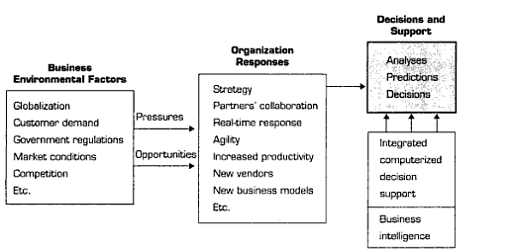
The Business Environment
Because of the modern factors, decision making is become complex requiring knowledge of business, data, data representation; hence a computerized system is required.

Slide 4
Different actions taken by managers to counter
the pressure:
• Employee strategic planning
• Use new and innovative business models
• Restructure business processes
• Participate in business alliances
• Improve corporate information system
• Respond quickly to competitor’s actions(e.g.in pricing, promotion, new products and services)
• Automate many tasks of white-collar employees
• Automate certain decision processes, especially those dealing with customers
• Improve decision making

Slide 5
Why we use computerized Decision Support System
• Speedy computations
• Improved communication and collaboration
• Increased productivity of group members
• Improved data management
• Managing giant data warehouses
• Quality support
• Agility support
• Overcoming cognitive limits in processing and storing information
• Using the web
• Anywhere, anytime support

Slide 6
Decision Support Frameworks(gory and scott morton[1971]

Slide 7
DEGREE OF STRUCTUREDNESS
Types of Decision
Structured | Structured problems are routine and typically repetitive problems for which standard solution methods exist.
Semistructured | Semistructured problems fall between structured and unstructured problems, having some structured elements and some unstructured elements.
Unstructured | Unstructured problems are fuzzy, complex problems for which there are no cut-and-dried solution methods.

Slide 8
TYPES OF CONTROL
TYPES OF CONTROL
Strategic planning | Which involves defining long-range goals and policies for resource allocation.
Management Control | The acquisition and efficient use of resources in the accomplishment of organizational goals
Operational control | The efficient and effective execution of specific tasks.

Slide 9
Simon’s decision making phases

Slide 10
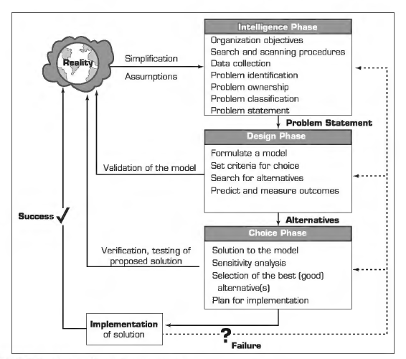

Slide 11
Common Strategies and Approaches of Decision Makers
State the situational goal
Identify the problem
Determining decision type
Generate Alternatives
Evaluate Alternatives
Choose an Alternative
Implementing the plan
Control

Slide 12
The role of Decision Support Systems(DSS)
“Decision support system couple the intellectual resources of individuals with the capabilities of the computer to improve the quality of decisions. It is a computer-based support system for management decision makers who deal with semi structured problems”
-By Keen and Scott-Morton(1978)

Slide 13
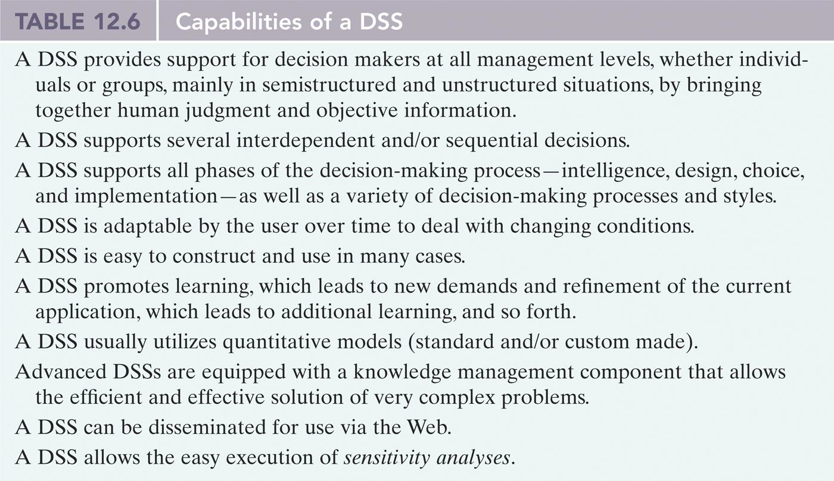
The role of Decision support systems(DSS)

Slide 14
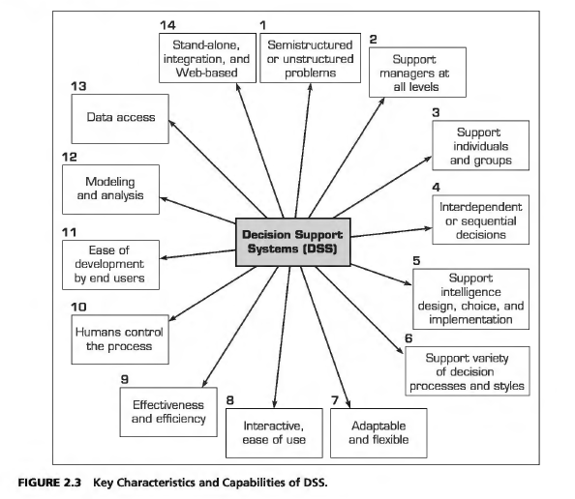

Slide 15
DSS main Components
Data
Models
Graphical user Interface
Decision Maker

Slide 16
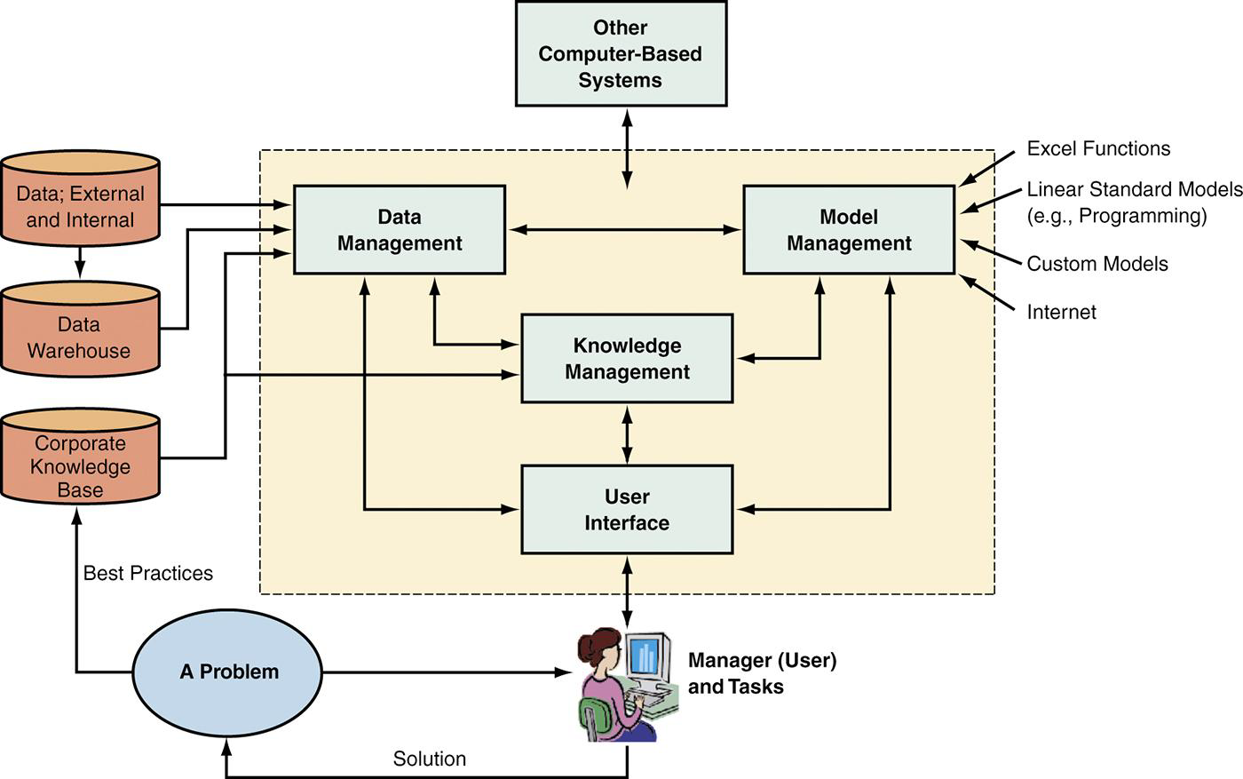

Slide 17
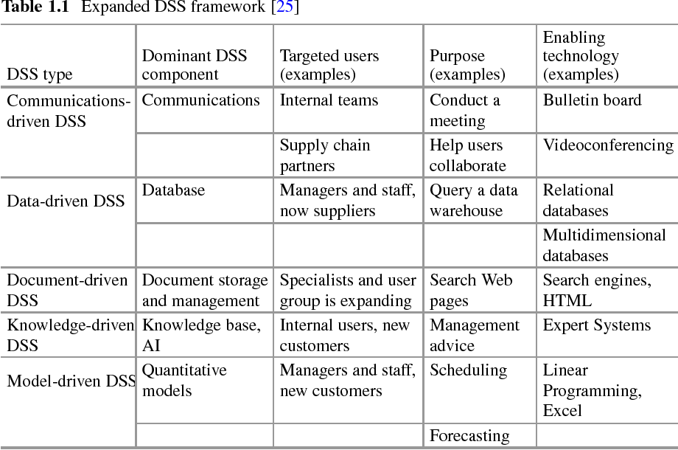

Slide 18
How DSS have changed Over Time
Changing DSS features or components over time.
Changing Technology on which the system is used.
Getting more efficient algorithms over time.
Evolving knowledge in the system over time.
Changing users and user preferences over time.

Slide 19
1. Common Day-to-Day Decision Support System Examples:
GPS route planning determines the fastest and best route between two points by analyzing and comparing multiple possible options. Many GPS systems also include traffic avoidance capabilities that monitor traffic conditions in real time, allowing motorists to avoid congestion.
Farmers use crop-planning tools to determine the best time to plant, fertilize and reap.
Medical diagnosis software that allows medical personnel to diagnose illnesses is another example.

Slide 20
2. Decision Support System Examples That Use Historical Data:
Historical data analysis, used in every facet of business and life, is well-developed and mature. Although such information is not always directly actionable, it's an important part of DSS because it reports past performance and highlights areas that need attention. Some examples include:
Descriptive analytics: Metrics such as sales results, inventory turnover and revenue growth.
Diagnostic analytics: Diagnostic information that digs a bit deeper to reveal results and explains reasons for past performance as measured by descriptive analytics.
Business intelligence (BI): Although largely based on historical data, BI solutions allow users to develop and run queries that are used to guide and support decision-making.
ERP dashboards: User-configurable dashboards that allow managers to monitor a variety of performance indicators.

Slide 21
3.Manual and Hybrid Decision Support System Examples:
Numerous manual techniques exist that support decision-making. These include activities such as the SWOT analysis where teams determine their organization's strengths and weaknesses as well as identifying threats facing the organization and potential opportunities for further growth. The outcomes of a SWOT analysis are actionable decisions for moving the organization forward. Other manual tools include decision matrixes, Pareto analyses and cost benefit analyses.
Hybrid DSS solutions include the use of spreadsheet analyses that tap into the capability of Excel to compute, analyze, compare options and evaluate what-if scenarios.
Although manual and hybrid DSS solutions are relatively slow and unwieldy, in the right hands, they are powerful decision support tools and many organizations rely on them.

Slide 22
4.DSS Software That Helps Predict Future Trends:
While it's essential to understand what happened in the past, and why it happened, this knowledge is of limited use when trying to predict the future, except possibly in very stable and predictable environments. However, this is hardly ever the case. Fortunately, techniques exist that make it possible to predict, with a degree of certainty, future trends and changes which will impact a company or business. For example, these tools can predict, based on past performance, external data and market feedback, figures for future product demand, product obsolescence and returns.
This is called predictive analytics and forms the basis of another type of DSS tool, one that helps predict what will happen in the near future. Predictive analytics use a combination of data mining, statistical tools and machine learning algorithms to determine the likelihood of certain events taking place. Banks use these techniques to detect fraud, insurance companies use them to evaluate risk, and ride-hailing firms to determine ticket prices based on demand.

